Slide 1
Simulation and Modeling
CSE4131_CSE4132

Slide 2
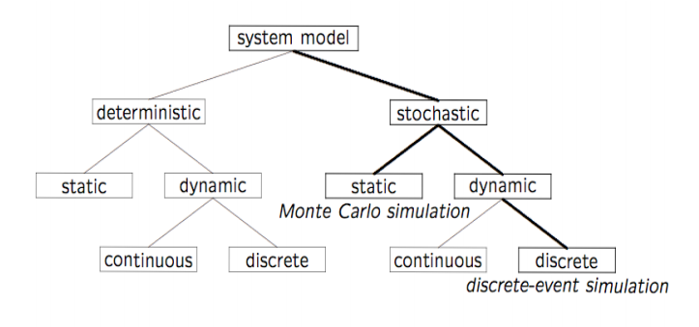
System Model Classification
Who uses random number…

Slide 3
Random Numbers
What is Random Number?
A random number is a number generated by a process,
whose outcome is unpredictable,
and which cannot be sub sequentially reliably reproduced.
This definition … one has some kind of a black box – such a black box is usually called a random number generator – that fulfills this task.
Random number plays important role in simulation tasks.

Slide 4
Properties of Random Numbers
A sequence of random numbers, R₁, R₂ … must have two important statistical properties:
Uniformity → ?
They are equally probable every where
Independence → ?
The current value of a random variable has no relation with the previous value.

Slide 5
Generation of Pseudo Random Numbers
Pseudo → False / Fake
Generation of False or Fake Random Numbers?
Pseudo → because generating numbers using a known method removes the potential for true randomness
Goal → To produce a sequence of numbers in [0,1] that simulates, or imitates, the ideal properties of random numbers (RN)

Slide 6
Generation of Pseudo Random Numbers
Important considerations in RN routines:
The routine should be fast
Portable to different computers… (different programming languages)
Have sufficiently long cycle
Replicable
Closely approximate the ideal statistical properties of uniformity and independence

Slide 7
Generation of Pseudo Random Numbers
When generating pseudo random numbers certain problem may occur:
Generated number may not be uniformly distributed
… may be discrete valued, instead of continuous valued
The mean of generated numbers… may too high or too low
The variance … may too high or too low.
There may be cyclic variation: i.e.
Autocorrelation between numbers
Numbers successively higher or lower than successive numbers
Several numbers above the mean followed by several numbers below the mean

Slide 8
Techniques of Generating Random Numbers
Different methods have been proposed:
Linear Congruential Method (LCM).
Combined Linear Congruential Generators (CLCG).
Random-Number Streams.

Slide 9
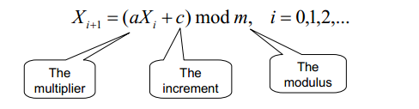
Linear Congruential Method (LCM)
Congruential → Congruent → Similar/ fitting /matching
Proposed by Lehmer (1951)
To produce a sequence of integers, X₁, X₂, …between 0 and m-1 by following a recursive relationship
The initial value of X₀ is called seed.
a is called constant multiplier.
c → increment
m → modulus

Slide 10

Linear Congruential Method (LCM)
If c ≠ 0 then → Mixed Congruential method
If c = 0 then → Multiplicative Congruential method
The random integers are being generated [0,m-1 ], and to convert the integers to random numbers:

Slide 11
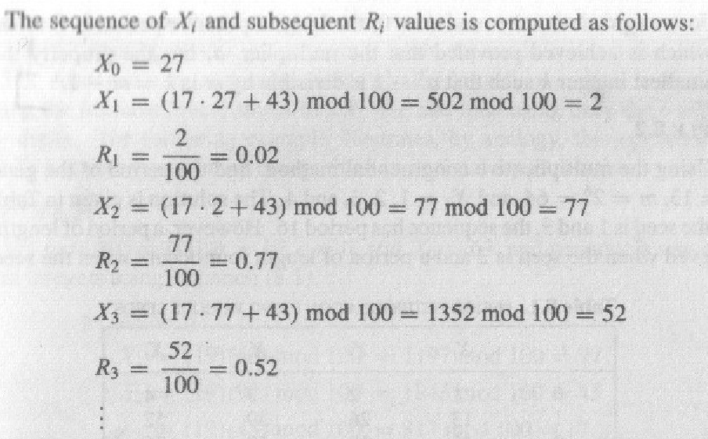
An Example
Given,
Seed (X₀ )= 27 ,
Constant multiplier (a) = 17 ,
Increment (c) = 43 , and
modulus (m) = 100.

